Slide 1


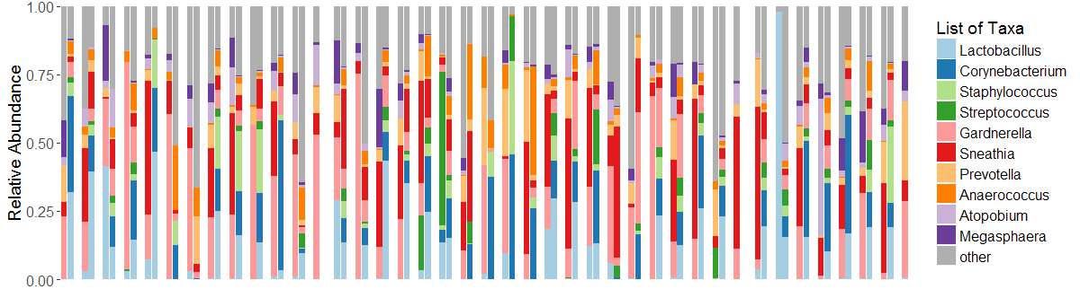
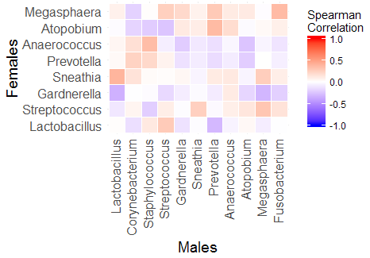
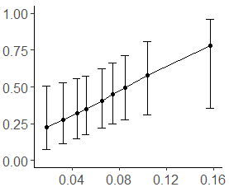
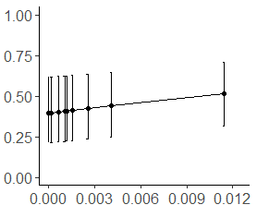
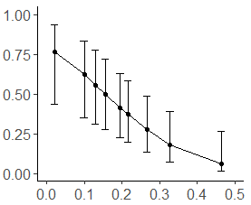
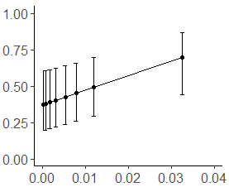
Bacterial Vaginosis recurrence at one month after treatment:
Role of baseline vaginal microbiome and sex partner penile microbiome
Rachel K. Nordgren¹, Fredrick Otieno³, Walter Agingu³, Winnie Odongo³, Dulal K. Bhaumik¹, Stefan Green², Robert C. Bailey¹, Supriya D. Mehta¹
¹ Division of Epidemiology & Biostatistics, University of Illinois at Chicago School of Public Health, Chicago, IL, USA
² Department of DNA Services, University of Illinois at Chicago, Chicago, IL, USA • ³ Nyanza Reproductive Health Society, Kisumu, Kenya
Background
Methods
Statistical Approach
Bacterial vaginosis (BV) is associated with increased risk of STD & HIV acquisition and transmission, and adverse pregnancy outcomes
Affects 20-50% of women in Sub-Saharan Africa and up to 30% of U.S. women
Treatment with sustained cure is lacking: recurrence of 30% within 3 months, and 50% within 6 months
Uncircumcised partner increases BV risk: uncircumcised men more likely to have BV-associated bacteria
Paired prospective data evaluating this association are lacking
We investigated which bacteria in the vaginal and penile microbiomes best predicted recurrence 1 month after treatment
Subject Characteristics at Baseline
Relative Abundance at Baseline of Top 10 Vaginal and Penile Taxa, Paired by Couple
Filter male and female genus-level taxa to remove those with less than 100 total reads, or at least 10 reads in 35% of the subjects.
Normalize samples by dividing by total number of reads (RA), and use the Centered Log Ratio transform (CLR)
Targeted bacterial taxa from prior studies
Iterative Sure Independence Screening (SIS) for selected taxa in the male and female microbiomes, recurrence as the outcome.
Logistic regression to model BV as a function of taxa chosen by SIS along with circumcision status and female HSV-2 status
Backwards variable selection using p<0.05
N=41 | Females | Males
Median Age in Years (range) | 22 (16-39) | 27 (18-35)
HIV positive (in total sample) | 21% (11%) | 15% (12%)
HSV-2 Seropositive (in total sample) | 78% (57%) | 50% (47%)
Circumcised (in total sample) |  | 46% (56%)
BV recurrence at 1 month | 22 (54%)
BV did Not Recur at 1 Month
BV Recurred at 1 Month
Relative Abundance of each taxa for each observation (CVL left, MEA right) within each couple (N=41), sorted on recurrence (recurred right of black line, did not recur left)
Bacterial Abundance Correlations across Selected Taxa at Baseline
Variable Selection and Modeling
Brighter red (positive) and blue (negative) colors depict strength of correlation.
Taxa chosen by SIS: MEA Gardnerella, MEA Sneathia, MEA Fusobacterium, CVL Gardnerella, CVL Anaerococcus, CVL Megasphaera, CVL Porphyromonas, CVL Diaslister.
Backwards selection (p<.05) removed MEA Sneathia, CVL Megasphaera, CVL Porphyromonas, CVL Dialister (R² = 0.30)
Circumcision and HSV-2 status not significant in the model.
Discussion & Conclusions
High rate of BV recurrence: non-adherence? Poor quality drugs? Looked too soon?
No difference in recurrence by metronidazole vs. tinidazole, symptoms
Penile Gardnerella and Fusobacterium were predictive of BV recurrence, independent of vaginal bacteria
Significant correlations between penile and vaginal taxa
Findings build on epidemiologic studies showing association between partner circumcision status and women’s risk of BV and recurrence
Opposing relationship between Gardnerella and BV recurrence for males and females likely reflects complex interaction of bacterial function and host response
Next steps are to quantify how much of recurrence is due to penile bacteria through mediation and interaction models and to conduct species level analysis
Design & Methods
 | Examined |  | Screened |  | Final Model
 | MEA | CVL | MEA | CVL | MEA | CVL
Gardnerella | X | X | X | X | X | X
Sneathia | X | X | X
Anaerococcus | X | X |  | X |  | X
Porphyromonas | X | X |  | X
Dialister | X | X |  | X
Fusobacterium | X |  | X |  | X
Megasphaera | X | X |  | X
Samples collected from 252 male and female sex partners residing in Kisumu, Kenya, at baseline and 1 month
Couple-level analyses were restricted to women with BV at baseline (N=53) and who had 1 month results (N=41)
39/41 women had documented BV treatment (tinidazole, metronidazole)
Covariates collected for both partners: socio-demographics, sexual practices, HIV, HSV-2
Cervicovaginal lavage (CVL) and clinician collected meatal swab (MEA) for vaginal and penile microbiomes
gDNA extracted from CVL and swabs was used to characterize the microbiome using high-throughput amplicon sequencing (Illumina MiSeq) of microbial 16S rRNA genes (V3-V4 region).
After basic processing (QIIME), sequence data were clustered at sub-OTU level; annotated using the SILVA 132
Variables examined and not selected: Corynebacterium (MEA), Staphylococcus (MEA), Peptoniphilus (MEA), Prevotella (MEA), Atopobium (MEA), Mobiluncus (MEA), Granulicatella (MEA), Lactobacillus (CVL), Shuttleworthia (CVL), Fastidiosipila (CVL)
Marginal Predicted Probabilities of BV Recurrence at One Month for
Taxa Selected in Final Multivariable Logistic Regression
Meatal Gardnerella
Meatal Fusobacterium
Cervicovaginal Gardnerella
Cervicovaginal Anaerococcus
Probability of Recurrence
Acknowledgements
NIH, NIAID, DMID R01 AI110369 (PI: Mehta)
Staff and participants in Kisumu
Log(Relative Abundance+1)

